Slide 1
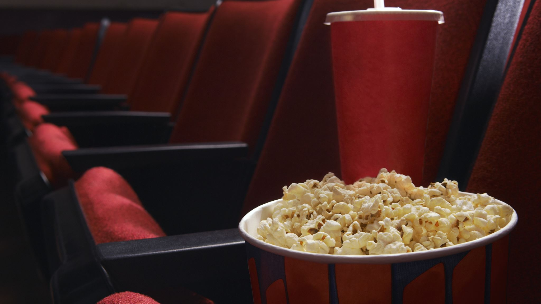

DEPI Web Project
GRADUATION PROJECT PRESENTATION

Slide 2


Team Members
Mahmoud Baligh Mahmoud
Mohamed Nader Rashad
Helmy Mohamed Elnahans
Mohamed ElShahat Mohamed
Ziad Emad AbdelFatah
Supervisor
Eng Khaled Sedki

Slide 3
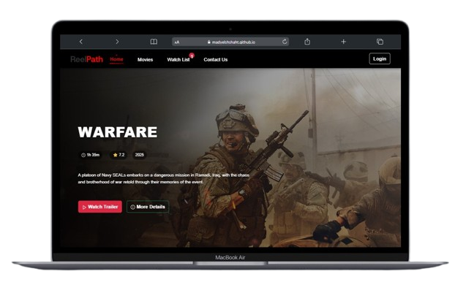
Overview
Home
Movies
Watch List
Contact Us
Login
Signup

Slide 4
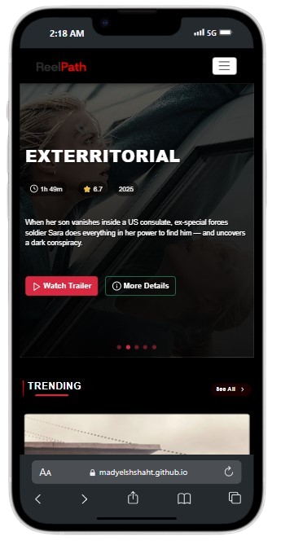
Overview
The following screens showcase different views of the Movie ReelPath website, designed to provide users with an engaging and informative movie browsing experience. Each screen focuses on delivering a specific functionality that enhances user interaction and exploration.
Movie Recommendations is a React-based web application built as part of a DEPI training project. It enables users to discover trending, top-rated, and popular movies through a clean and responsive interface. The app integrates with the TMDB API to fetch real-time movie data and offers features like genre-based filtering, detailed movie information, and search functionality.
The application utilizes React Router for seamless navigation, Axios for efficient API communication, and Bootstrap for consistent, responsive UI styling. Additional libraries such as React Toastify and React Icons enhance usability and aesthetics. Movie Recommendations is optimized for performance and designed to deliver a smooth user experience across different screen sizes.

Slide 5





Project Timeline
Idea Generation
Development Phase
Testing
Launch
Feedback
The team brainstormed and refined concepts to create an engaging website experience.
Using React.js and Node.js, the team worked diligently to build the project.
Extensive testing was conducted to ensure a seamless user experience across all pages.
The project was officially launched, showcasing the team's hard work and dedication.
User feedback was collected to enhance the platform's functionality and user satisfaction.

Slide 6


React.js Overview
Node.js Benefits
MongoDB Features
React.js allows for efficient UI development using reusable components, making the user interface of our project interactive and responsive.
Node.js enables server-side JavaScript, providing a fast and scalable environment for building the backend of our web application.
MongoDB is a NoSQL database that allows flexible data storage, making it ideal for managing varied data structures in our project.
Core Technologies of Our Project

Slide 7
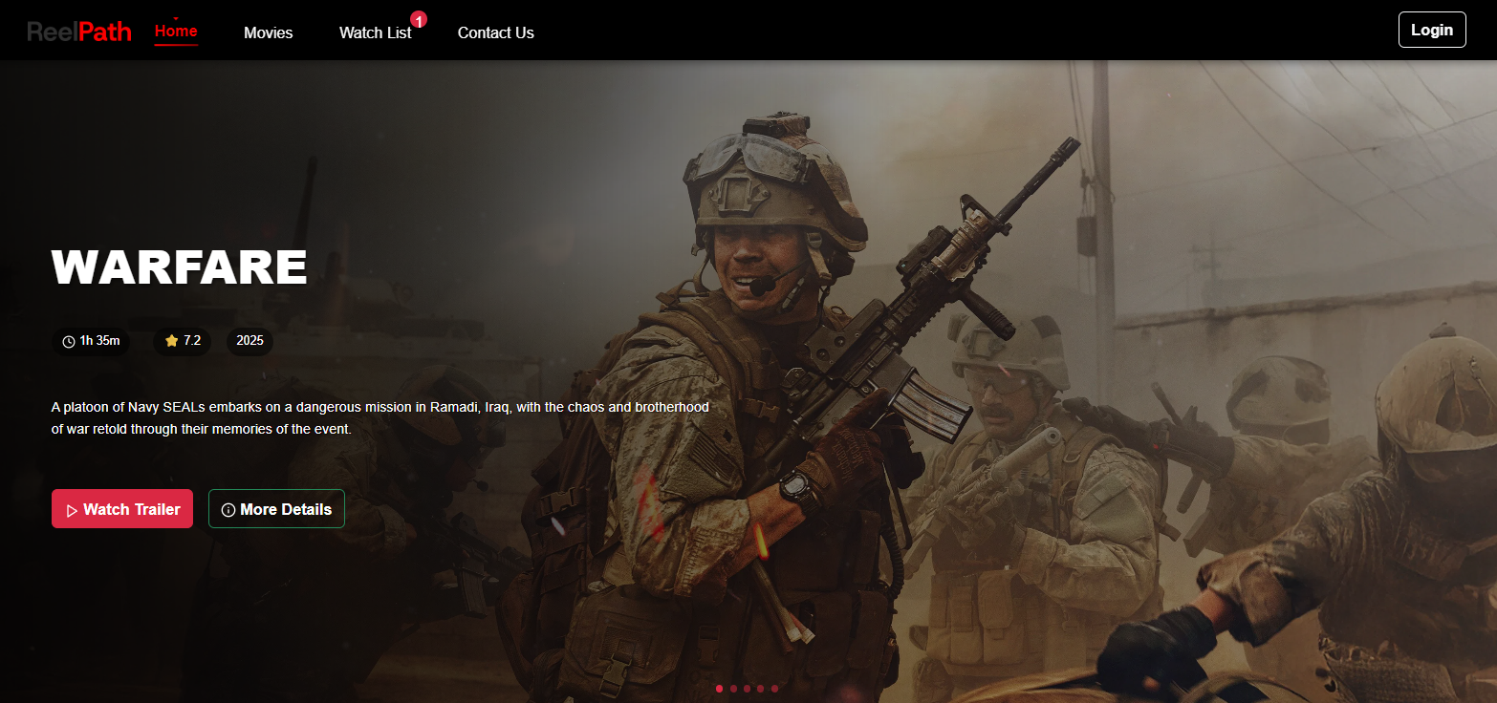
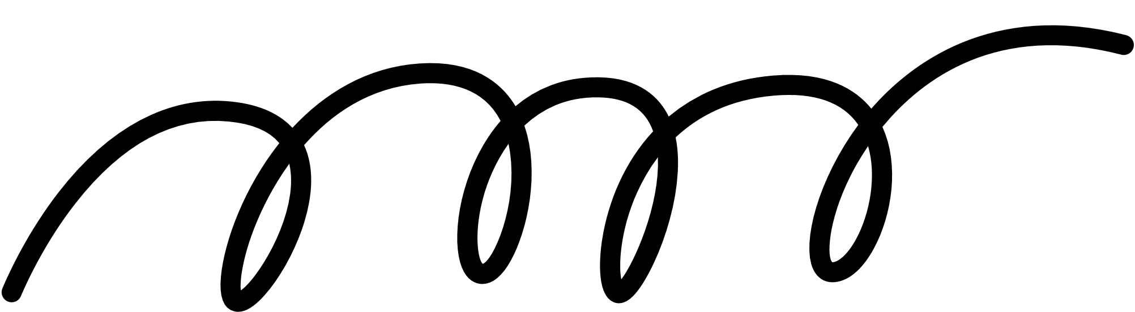
Home Page Features
User-Friendly Design
The home page offers an intuitive layout, simplifying navigation for users to find their favorite content quickly.
Personalized Recommendations
The platform provides tailored suggestions based on user preferences, enhancing the overall viewing experience significantly.

Slide 8


Movie Features
The Movie Page provides users with an immersive experience to explore their favorite films. It offers detailed descriptions, ratings, and genres, ensuring that users can easily find what they want. Additionally, engaging visuals enhance the overall browsing experience, bringing each movie to life.
Users can also leave reviews and ratings, fostering a sense of community. The design elements follow the Black and Red theme, creating a striking visual impact. This combination of functionality and aesthetics makes the Movie Page a highlight of our project.

Slide 9
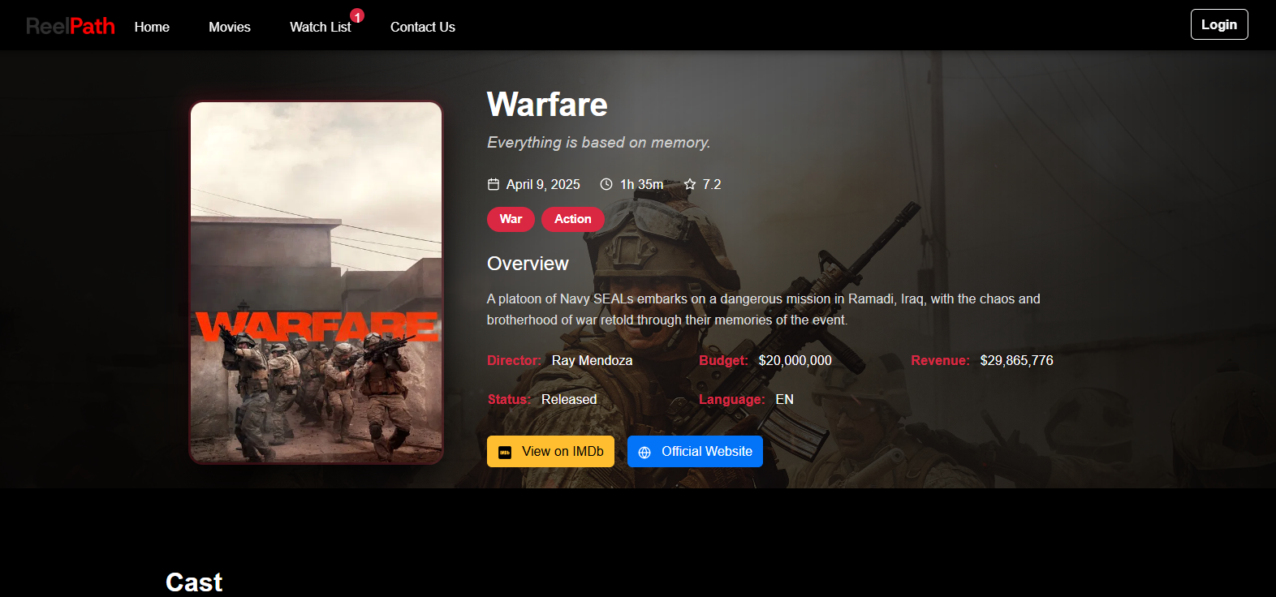
Movie Details
User-Friendly Design
The home page offers an intuitive layout, simplifying navigation for users to find their favorite content quickly.
Personalized Recommendations
The platform provides tailored suggestions based on user preferences, enhancing the overall viewing experience significantly.

Slide 10
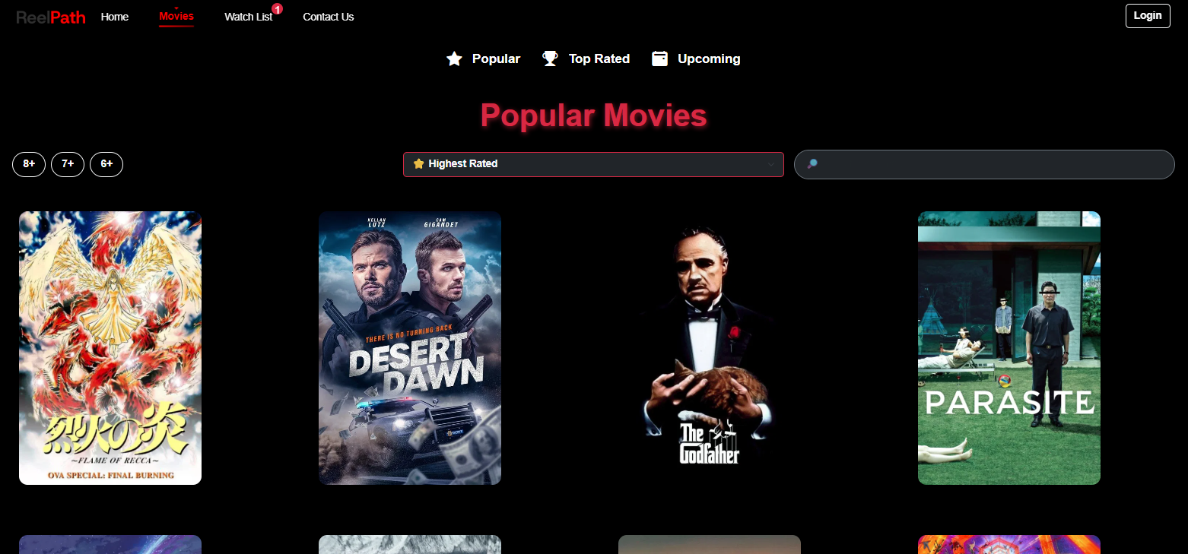
Movie Page
User-Friendly
Designed with simplicity and ease of use in mind, the interface provides an engaging experience, allowing users to effortlessly explore and access their favorite shows.
Dynamic Content
The page features real-time updates on the latest movies, ensuring viewers never miss their favorite shows.

Slide 11
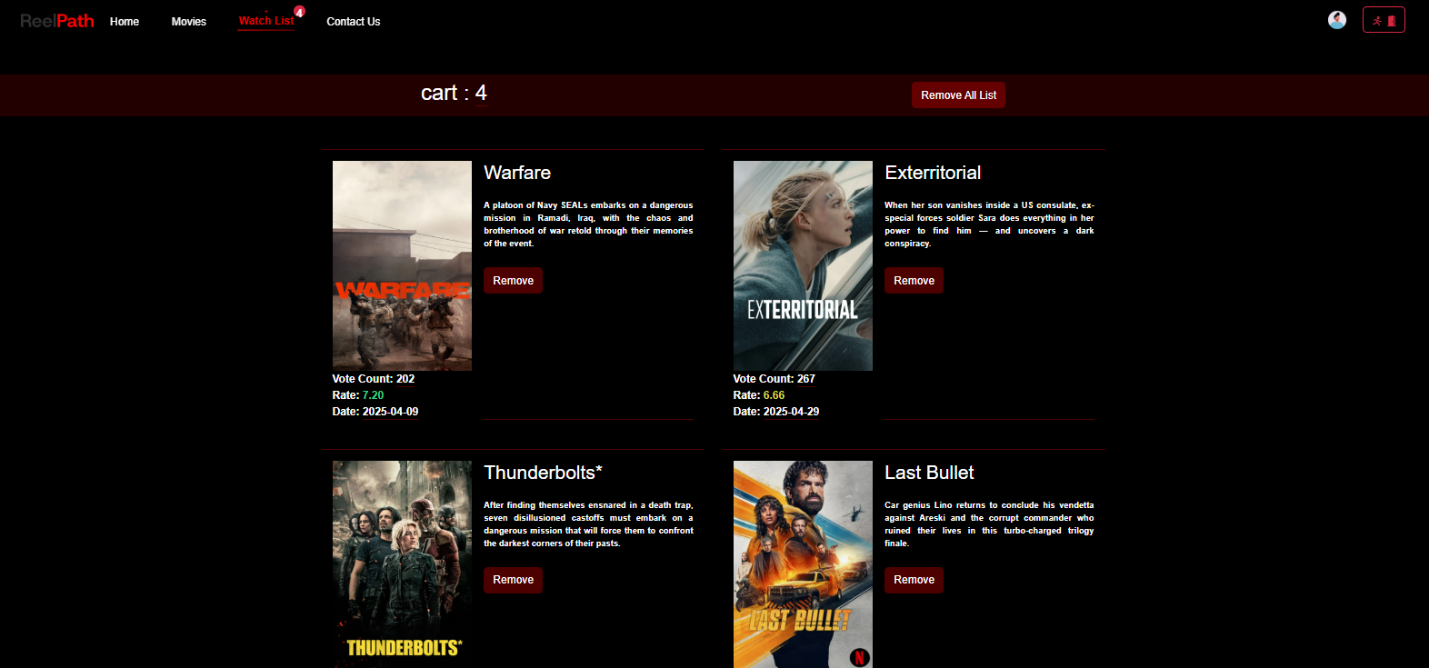
Watch List Features
Easy Accessibility
Users can quickly add movies and shows to their watch list with just one click.
Personalized Recommendations
The watch list will suggest content based on users' viewing habits and preferences.

Slide 12
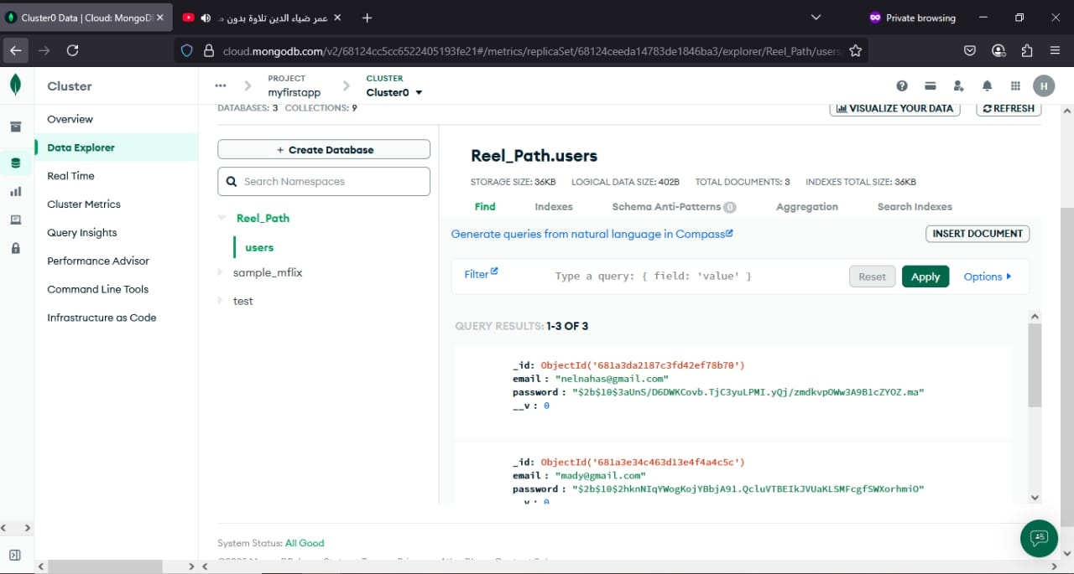
Back-End Node.js
Our web application's backend is powered by Node.js and MongoDB, enabling fast, scalable, and efficient data handling.
Node.js provides a non-blocking, event-driven server, perfect for handling real-time API requests and smooth data flow between frontend and backend.
MongoDB is a NoSQL database that stores data in a flexible, JSON-like format, allowing us to manage dynamic user-generated content like watchlists, user accounts, and media data efficiently.
Together, they form a powerful backend stack that supports real-time features and high performance across our application.

Slide 13
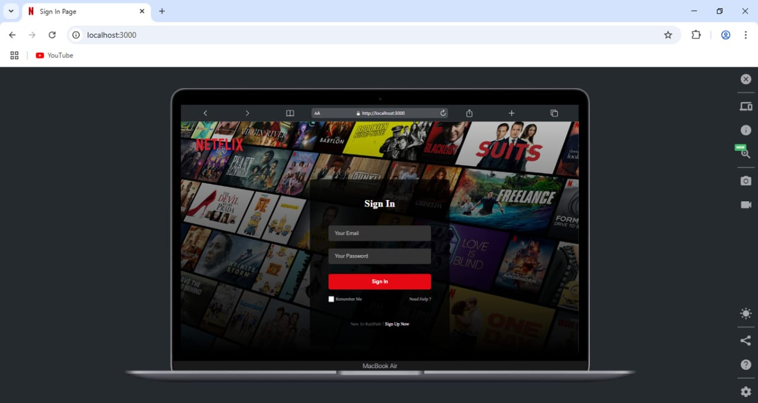
Login Page Concepts
Intuitive Design
A streamlined user experience ensures quick access to their favorite content.
Security Features
Implementing strong security measures builds user trust and protects personal information effectively.

Slide 14

Signup Page Features
Secure Authentication
To ensure user privacy and data protection, the page includes secure authentication measures, such as password strength indicators and email verification.
Social Media Integration
For added convenience, users can sign up using their existing social media accounts (Google, Facebook, etc.), saving time and reducing the friction of manual entry.

Slide 15
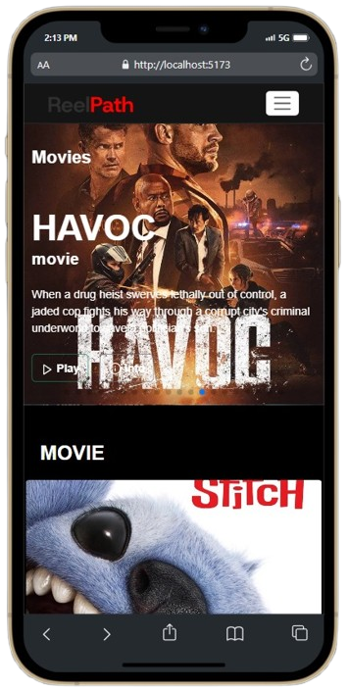
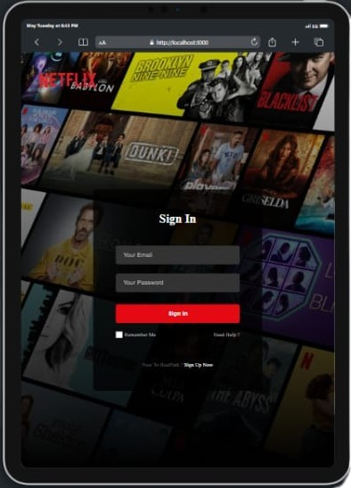
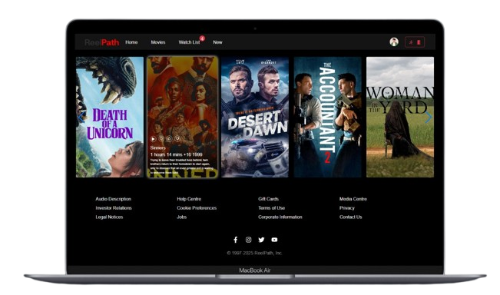
Responsive Website
To ensure a seamless user experience across all devices (mobile, tablet, desktop), we integrated Bootstrap into our project.
Bootstrap’s responsive grid system, pre-built components, and utility classes allowed us to:
Build a mobile-first layout
Ensure fluid resizing across screen sizes
Use responsive navigation bars, cards, and modals
Speed up development with consistent styling
By leveraging Bootstrap, we achieved a modern, responsive design without reinventing the wheel.

Slide 16
Color Psychology
Brand Identity
Visual Cohesion
The black and red theme evokes strong emotions, creating an engaging atmosphere that captures user attention effectively.
This color scheme aligns with our brand's vision, emphasizing sophistication and energy to resonate with our target audience.
Utilizing black and red throughout the design ensures visual consistency, enhancing user experience across various pages of the application.
Exploring Our Black and Red Theme

Slide 17

Overcoming Development Challenges
Key Issues
API Integration & Data Handling Integrating the TMDB API required a strong understanding of asynchronous data fetching and efficient state updates. We resolved data loading issues by using Axios and managing responses carefully, including loading states and error handling.
Routing & Navigation Implementing React Router for seamless navigation between pages like Home, Movies, Watchlist, and Contact Us posed some initial issues with path structure and component rendering. These were resolved through clear route hierarchy and consistent component structure.
Team Collaboration Dividing tasks and maintaining clean, merge-friendly code required setting GitHub collaboration rules, like feature branches and clear commit messages. Regular communication helped us stay aligned throughout the process.

Slide 18
Overcoming Development Challenges
State Management Managing shared state, especially for features like the Watchlist, required proper prop drilling and local state control. We considered lifting state and using context for better scalability.
Responsive UI Design Ensuring the app looked and functioned well on different screen sizes was another key challenge. We used Bootstrap to implement a responsive grid layout and styled components consistently across the project.
Authentication Flow For the Login and Signup pages, simulating authentication and form validation required extra care in managing form state and error messages. We implemented input validation and basic local/session storage logic for a smooth user experience.

Slide 19
Future Enhancements for Our Project
Continuous Improvement
Comments:
Let users discuss movies in real-time or post threaded comments.
Personalized Recommendation Feed:
Use collaborative filtering or ML models (even basic ones) to suggest based on similar users' choices
Progress Tracker:
Let users mark a movie as “Watched,” “Watching,” or “Plan to Watch.”
Social Sharing:
Share movie lists or watchlists with friends on social media.
Achievements / Badges:
Gamify the experience. Give badges like “Horror Buff” or “100 Movies Watched.”

Slide 20
Team Contributions
Project Conceptualization
Design Phase
Development Stage
Testing and Debugging
Final Presentation
The team brainstormed ideas and defined project goals to ensure clarity and focus.
Each member contributed to creating wireframes and mockups for a user-friendly interface.
Helmy and Mohamed led the backend development using Node.js and MongoDB effectively.
Ziad and Mahmoud conducted extensive testing to identify and resolve issues before launch.
The team collaboratively developed the presentation to showcase their work and achievements.

Slide 21

Project Goals and Objectives
Overview of our project objectives
Create a user-friendly interface for navigation
Implement secure user authentication and authorization
Provide a comprehensive database of movies and shows
Enhance user engagement through personalized recommendations

Slide 22
Repo in Github
Live Demo

Slide 23

Thank You
DEPI

